Slide 1
CaR Accident severity
Capstone project

Slide 2
1. Introduction
Problem
Road traffic injury is a serious problem because people may be left with physical or psychosocial disabilities and road accidents lead to financial loss.
Purpose of this report
Find out the relation among severity and surrounding conditions
Make suggestions to reduce the number of traffic accidents
Who interested in?
Drivers, local residents and administration
The result led from data analysis will change the public awareness

Slide 3
2-1. Data resource and Understanding
Dataset : collisions that took place for a period(2004-2020) in Seattle, USA.
Contain 194673 cases and 37 attributes
(severity, situations of accidents, causes of accidents and surrounding conditions)
Choice of dependent and independent variables
Dependent variable
Independent variables
Severity Code | Status
3 | Fatality
2b | serious injury
2 | injury
1 | prop damage
0 | unknown
Address type
Junction type
Weather
Road condition
Light condition

Slide 4
2-2. Data Cleaning
Step1
Retrieve SEVERITYCODE, ADDRTYPE, JUNCTIONTYPE, INATTENTIONIND, UNDERINFL, WEATHER, ROADCOND, LIGHTCOND, PEDROWNOTGRNT and SPEEDING from data
Step2
Remove the cases caused by the human factors, INATTENTIONIND, UNDERINFL, PEDROWNOTGRNT and SPEEDING from the above data
Step3
Drop NaN data, “Unknown” and “Other” because we would like to predict the severity in collision more accurately. In addition, drop “Oil” from ROADCOND which is considered as a human factor

Slide 5
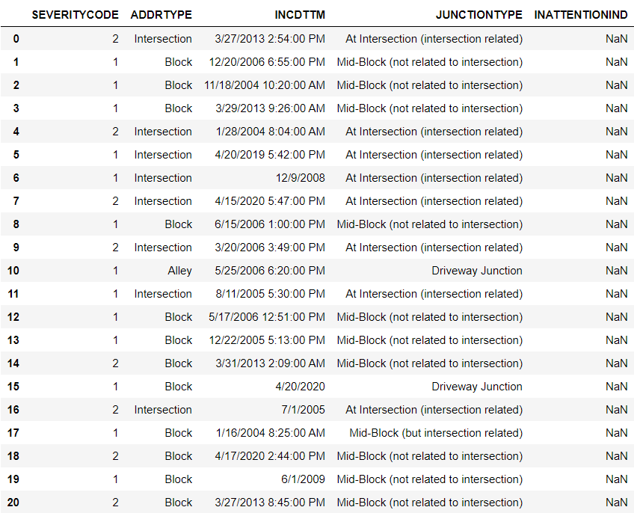
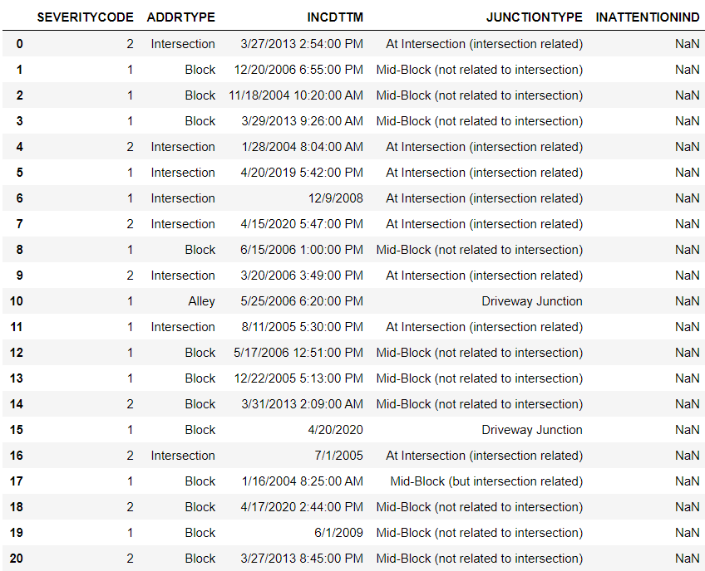
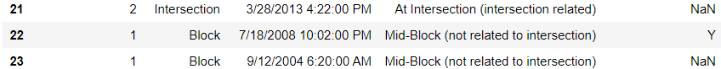
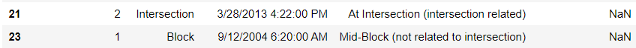
2-2. Data Cleaning
Example of Step2 (drop human factor cases)

Slide 6
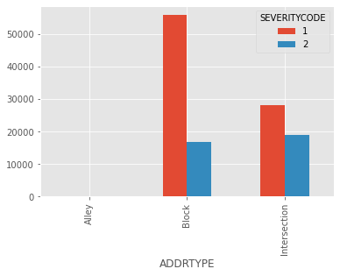
2-3. Overview of data
ADDRTYPE | # of collisions
Block | 126926
Intersection | 65070
Alley | 751

Slide 7
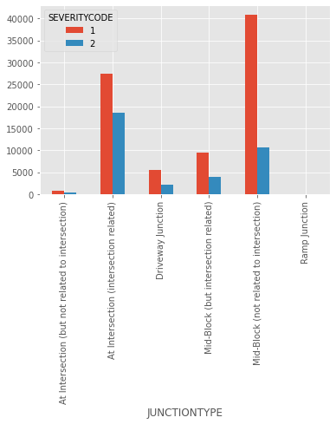
2-3. Overview of data
JUNCTIONTYPE | # of collisions
Mid-Block (not related to intersection) | 89800
At Intersection (intersection related) | 62810
Mid-Block (but intersection related) | 22790
Driveway Junction | 10671
At Intersection (but not related to intersection) | 2098
Ramp Junction | 166

Slide 8
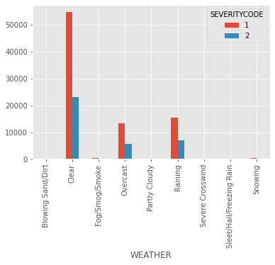
2-3. Overview of data
WEATHER | # of collisions
Clear | 111135
Raining | 33145
Overcast | 27714
Snowing | 907
Fog/Smog/Smoke | 569
Sleet/Hail/Freezing Rain | 113
Blowing Sand/Dirt | 56
Severe Crosswind | 25
Partly Cloudy | 5

Slide 9
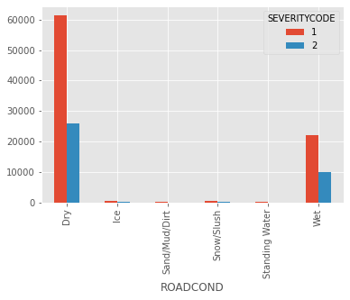
2-3. Overview of data
ROADCOND | # of collisions
Dry | 124510
Wet | 47474
Ice | 1209
Snow/Slush | 1004
Standing Water | 115
Sand/Mud/Dirt | 75

Slide 10
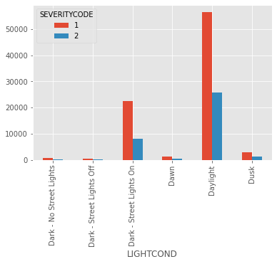
2-3. Overview of data
LIGHTCOND | # of collisions
Daylight | 116137
Dark - Street Lights On | 48507
Dusk | 5902
Dawn | 2502
Dark - No Street Lights | 1537
Dark - Street Lights Off | 1199
Dark - Unknown Lighting | 11

Slide 11
3-1. Model Building
Model building by Decision Tree and Random Forest with python
By visualization of trees, it is easy to understand what surrounding conditions cause more severe collisions.
pandas.get_dummies()
Before machine learning, we convert categorical variables into indicator variables.
In addition, we transforme severity2 to “1” and severity1 to “0”

Slide 12
3-1. Model Building
Decision Tree : supervised machine learning for classification
“criterion” : entropy
“max_depth” : 2(determined by grid search with cross validation)
“class_weight” : default and balanced
Random Forest : ensemble of decision trees
“criterion” : entropy
“max_depth” : 2(used the result of decision tree)
“n_estimators” : 50
“class_weight” : default and balanced

Slide 13
3-2. Results
Precision, Recall and f1-score for each model
Decision Tree without balanced
Random Forest without balanced
 | precision | Recall | f1-score
Severity 1 | 0.70 | 1.00 | 0.83
Severity 2 | 0.00 | 0.00 | 0.00
accuracy |  |  | 0.70
macro avg | 0.35 | 0.50 | 0.41
weighted avg | 0.50 | 0.70 | 0.58
 | precision | Recall | f1-score
Severity 1 | 0.70 | 1.00 | 0.83
Severity 2 | 0.00 | 0.00 | 0.00
Accuracy |  |  | 0.70
macro avg | 0.35 | 0.50 | 0.41
weighted avg | 0.50 | 0.70 | 0.58
Not Good
Decision Tree with balanced
RandomForest with balanced
Good Models
 | precision | Recall | f1-score
Severity 1 | 0.77 | 0.68 | 0.72
Severity 2 | 0.40 | 0.52 | 0.45
accuracy |  |  | 0.63
macro avg | 0.59 | 0.60 | 0.59
weighted avg | 0.66 | 0.63 | 0.64
 | precision | Recall | f1-score
Severity 1 | 0.77 | 0.67 | 0.72
Severity 2 | 0.40 | 0.53 | 0.46
Accuracy |  |  | 0.63
macro avg | 0.59 | 0.60 | 0.59
weighted avg | 0.66 | 0.63 | 0.64

Slide 14
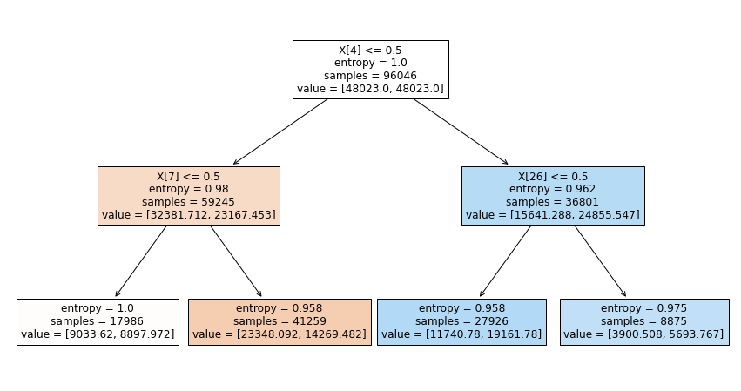
4-1. Visualization of tree
# of Severity 1
# of Severity 2
Not At Intersection
(intersection related)
At Intersection
(intersection related)
“At Intersection(intersection related)” is important factor
True
False
True
False
The increase of entropy means it is difficult to distinguish

Slide 15
4-2. discussion
To reduce severe collisions(severity2), it is a good way to give drivers a warning at intersection.
To establish a better model to distinguish severity1 and severity2 case, we may need to consider other surrounding factors except given information.

Slide 16
5. Conclusion
1. Built Decision Tree with balanced and Random Forest with balanced models
2. Found out that “At Intersection(intersection related)” has important impact
by visualization of the tree
3. Need to collect more information about surrounding situations to build
a better model

